Slide 1
DAY-1 DOCUMENTATION
what is cloud computing ?
AWS and its components?
Brief understanding about EC2 and its components?

Slide 2
What is cloud computing ?
Cloud computing is the delivery of different services through the Internet, including data storage, servers, databases, networking, and software. Cloud storage has grown increasingly popular among individuals who need larger storage space and for businesses seeking an efficient off-site data back-up solution.
Cloud computing is typically categorized into two main models:
Deployment Model
Service Model

Slide 3
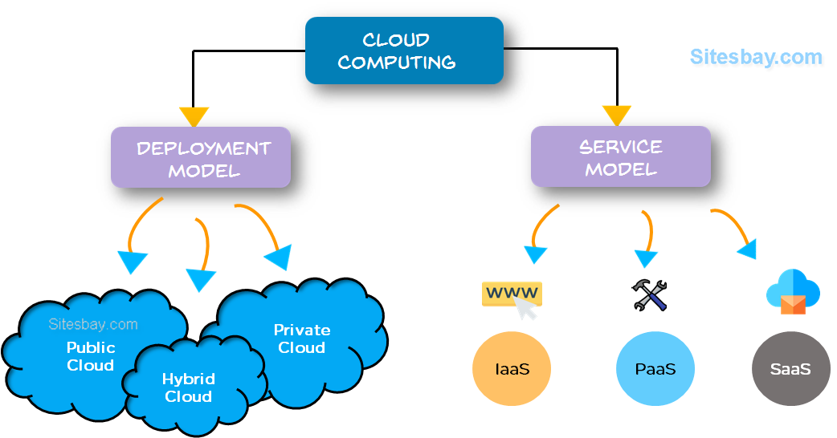

Slide 4
Additionally, cloud computing deployment models include:
Public Cloud:
Services are provided over the public internet and are available to anyone who wants to use them. Resources are shared among multiple users.
Private Cloud:
Cloud infrastructure is used exclusively by a single organization. It can be managed by the organization itself or a third party.
Hybrid Cloud:
Combines public and private clouds, allowing data and applications to be shared between them. This model provides greater flexibility and optimization of existing infrastructure.

Slide 5
Cloud computing is typically categorized into three main service models:
Infrastructure as a Service (IaaS):
Provides virtualized computing resources over the internet. Users can rent virtual machines, storage, and networks on a pay-as-you-go basis.
Platform as a Service (PaaS):
Offers a platform allowing customers to develop, run, and manage applications without dealing with the complexities of infrastructure. PaaS includes tools for application development, such as databases, development frameworks, and middleware.
Software as a Service (SaaS):
Delivers software applications over the internet on a subscription basis. Users can access applications without worrying about installation, maintenance, or infrastructure.

Slide 6
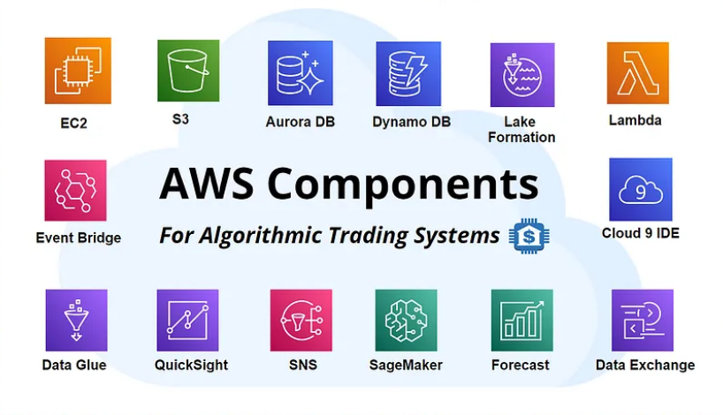
AWS and its components?
Amazon Web Services (AWS) is a comprehensive and widely used cloud computing platform provided by Amazon. AWS offers a vast array of services, allowing users to access computing power, storage, databases, machine learning, analytics, and more, on a pay-as-you-go basis. Here's an overview of some key AWS components and services:

Slide 7
Compute Services:
Amazon EC2 (Elastic Compute Cloud): Provides resizable compute capacity in the form of virtual servers (instances).
AWS Lambda: Enables serverless computing, allowing you to run code in response to events without the need to provision or manage servers.
Storage Services:
Amazon S3 (Simple Storage Service): Object storage service for scalable and secure storage of data.
Amazon EBS (Elastic Block Store): Provides persistent block-level storage volumes for use with EC2 instances.
Amazon Glacier: Low-cost storage service for data archiving and long-term backup.

Slide 8
3.Database Services:
Amazon RDS (Relational Database Service): Managed relational database service supporting multiple database engines.
Amazon DynamoDB: Fully managed NoSQL database service.
Amazon Redshift: Fully managed data warehouse service for analytics.
4.Networking:
Amazon VPC (Virtual Private Cloud): Allows users to provision a logically isolated section of the AWS Cloud.
Amazon Route 53: Scalable domain name system (DNS) web service.
Elastic Load Balancing (ELB): Distributes incoming application traffic across multiple EC2 instances.
5.Security and Identity:
AWS Identity and Access Management (IAM): Manages access to AWS services and resources securely.
AWS Key Management Service (KMS): Centralized key management service for creating and controlling encryption keys.
Amazon GuardDuty: Managed threat detection service that continuously monitors for malicious activity.

Slide 9
6.Machine Learning and AI:
Amazon SageMaker: Fully managed service for building, training, and deploying machine learning models.
Amazon Polly: Text-to-speech service.
Amazon Rekognition: Image and video analysis service.
7.Analytics:
Amazon Athena: Query service that enables analysis of data in Amazon S3 using standard SQL.
Amazon Redshift: Data warehouse service for analytics.
Amazon EMR (Elastic MapReduce): Cloud-based big data platform.
8.Developer Tools:
AWS CodeCommit: Version control service.
AWS CodeBuild: Fully managed build service.
AWS CodeDeploy: Automates code deployments to any instance, including EC2 instances and Lambda functions.

Slide 10
9.Management and Monitoring:
Amazon CloudWatch: Monitoring and observability service.
AWS CloudTrail: Records AWS API calls for auditing and compliance.
AWS Config: Tracks resource inventory and changes.
10.Internet of Things (IoT):
AWS IoT Core: Connects devices to the cloud and enables communication between them.
AWS IoT Greengrass: Extends AWS IoT functionality to devices.

Slide 11
Brief understanding about EC2 and its components
Amazon Elastic Compute Cloud (Amazon EC2) is a web service provided by Amazon Web Services (AWS) that enables users to run virtual servers, commonly referred to as instances, in the cloud. EC2 instances can be used for various computing purposes, such as hosting websites, running applications, and performing data processing tasks. Here's a brief understanding of EC2 and its key components:
Instances:
EC2 instances are virtual servers in the cloud that can run various operating systems, including Linux and Windows.
Users can choose from a variety of instance types based on their specific needs, such as compute-optimized, memory-optimized, storage-optimized, etc.
Instances can be started, stopped, terminated, and resized according to the user's requirements.

Slide 12
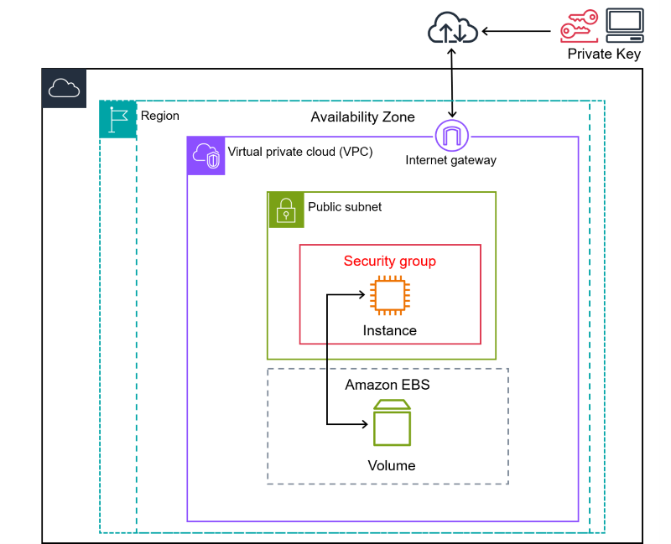

Slide 13
2.Amazon Machine Images (AMIs):
AMIs are pre-configured templates that contain the necessary information to launch an EC2 instance.
Users can choose from a range of public AMIs provided by AWS or create their own custom AMIs, which may include the operating system, applications, and other software configurations.
3.Key Pairs:
When launching an EC2 instance, users can associate a key pair with it, which consists of a public key and a private key.
The private key is used to securely SSH into Linux instances or decrypt Windows passwords for Windows instances.
4.Security Groups:
Security Groups act as virtual firewalls for EC2 instances, controlling inbound and outbound traffic.
Users can define rules within security groups to specify the allowed traffic based on protocols, ports, and IP ranges.

Slide 14
5.Elastic Block Store (EBS):
EBS provides persistent block-level storage volumes that can be attached to EC2 instances.
EBS volumes are used for storing data and can be detached from one instance and attached to another, allowing for data persistence.
6.Elastic Load Balancer (ELB):
ELB automatically distributes incoming application traffic across multiple EC2 instances to ensure high availability and fault tolerance.
There are different types of ELBs, including Classic Load Balancer, Network Load Balancer, and Application Load Balancer.
7.Auto Scaling:
Auto Scaling allows users to automatically adjust the number of EC2 instances based on demand.
Scaling policies can be defined to automatically launch or terminate instances to maintain a desired capacity.
8.Regions and Availability Zones:
AWS has data centers located in different geographic regions, and each region consists of multiple Availability Zones (AZs).
Users can deploy EC2 instances in different regions and leverage multiple AZs for increased fault tolerance and high availability.

Slide 15
Thank You

